Slide 1
Alert System for Car Hacking INTERNALLY FUNDED STUDENT PROJECT – 2017-2018
DONE BY
GUIDED BY
Mayank Singh
Devanathan N G
Dr.Chithra Selvaraj
Associate Professor
Department of Information Technology
SSN College of Engineering

Slide 2
PROBLEM STATEMENT
The objective of the project is to build a system which can help to prevent a car from theft from the wireless attacking methods used by the hackers.
This project is basically about alerting the owner of the car when his/her car is attacked by strangers. In the current scenario, the cars are being hacked through an external device like radio attack, which can interface with the electronic setup of the embedded systems in the car on wireless mode.

Slide 3
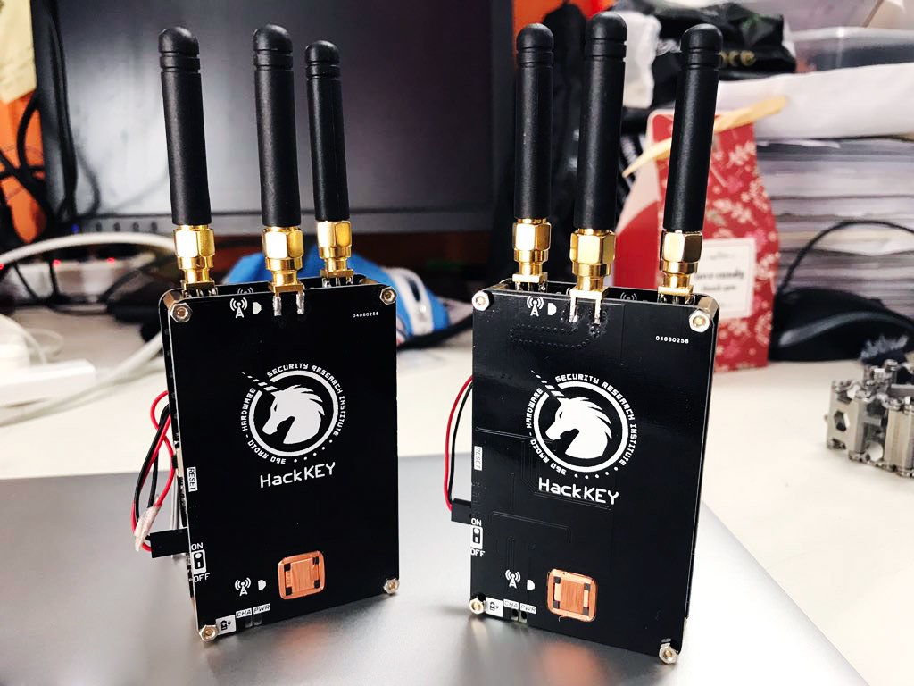

How is Car Hacking Done?
It is done using a device called “Radio Attack”, calloquially known as Hacckey by hackers.

Slide 4


Slide 5
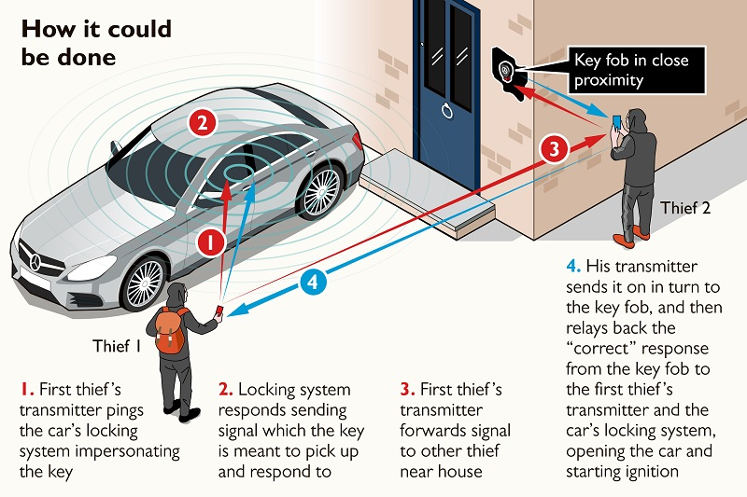
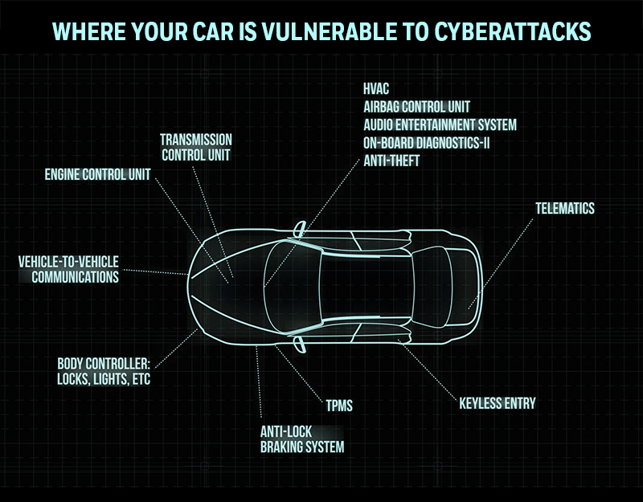
The attack in its essence is not new, and it’s basically just creating a range extender for the keyfob. One radio device is placed near the car, the other near the car key, and the two radios relay the signals coming from the car to the keyfob and vice-versa.

Slide 6
Objectives
To verify authentication of the on-board devices of the car with external devices
To perform two-factor authentication
To alert the owner of the car if there is any suspicious activity from external device.
The car should be already configured with the owner like(on body detection,mobile control,getting the mac address of the mobile,trusted devices) and also the car key should be given an unique id so that the alerting does not occur if the car is unlocked using the key.

Slide 7
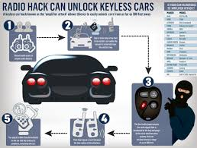

Motivation
The definition of problems with the existing system are:
To verify authentication of the on-board devices of the car with external devices .
Check if they were from trusted sources.
If they are not from the trusted sources,then alert the owner of the car.

Slide 8


Technical Perspective
This project uses the technical concepts as:
Internet of Things – to interface with the keyless remote and to perform both device level and user level authentication.
Cloud Computing – transmitting the data to remote location

Slide 9
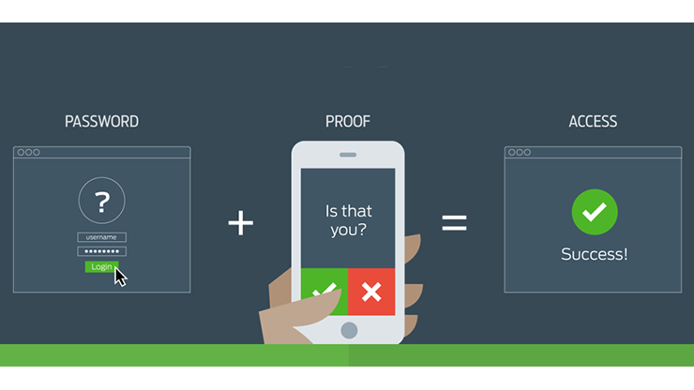

Proposed Solution
In this project, it is planned to use a microcontroller as a on-board device in the car so that the controller can maintain the key credentials of the user. It is plan to use the concept of IoT to interface with the keyless remote and to perform both device level and user level authentication.

Slide 10
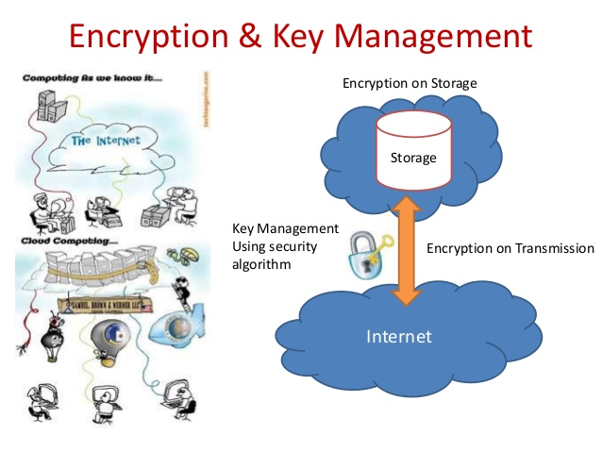
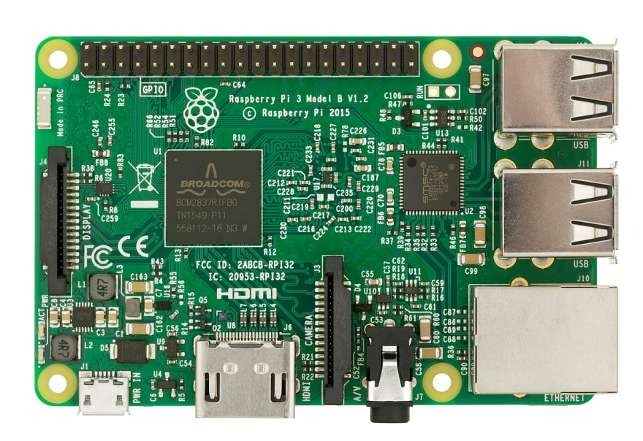
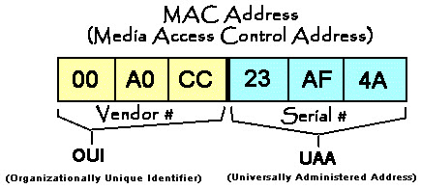
Device level authentication – The device level authentication is planned to verify the MAC address of the device using the microcontroller which would be unique for the device.
User level authentication – The user level authentication is planned to be performed using the cryptographic techniques with the key credentials of the user.

Slide 11
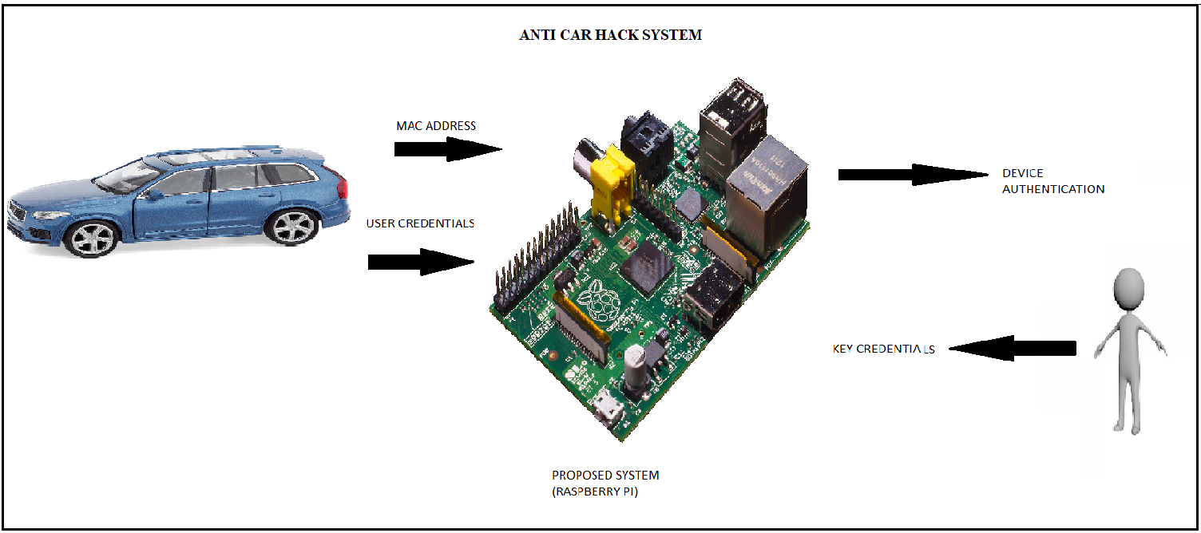
MECHANISM

Slide 12
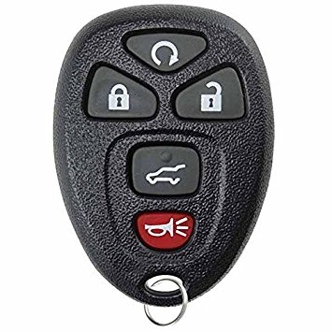
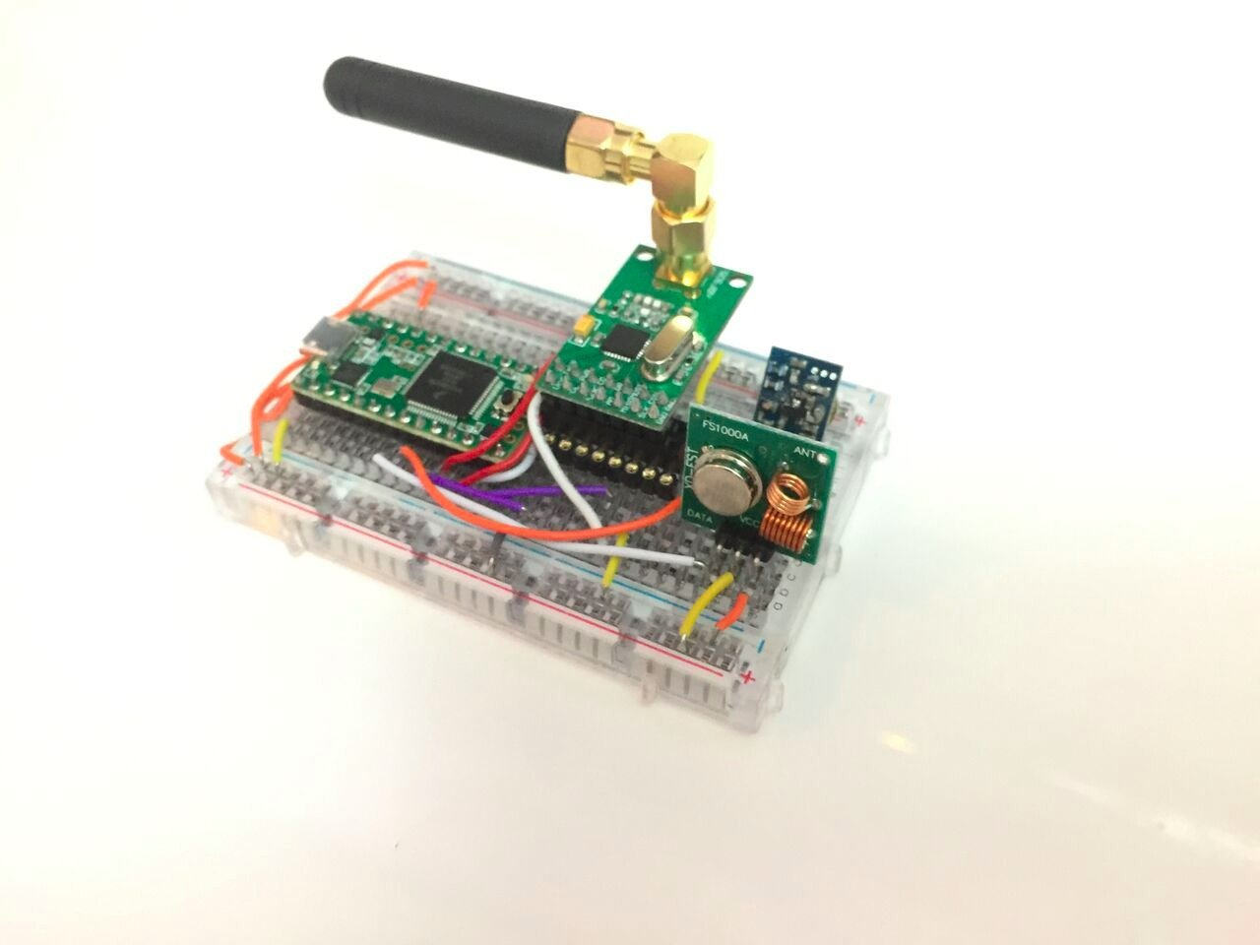

COMPONENTS
Raspberry PI Board – Microcontroller
Keyfob – wireless key entry used for cars
Wireless hackkey – hacking device used for testing the process of hacking
RF / Bluetooth communication module – provides interface between the keyfob

Slide 13
BUDGET
S.No. | Item | Quantity | Unit cost (Rs.) | Total Cost (in Rs.)
1 | Raspberry PI Board | 1 | 3500 | 3500
2 | Keyfob | 1 | 500 | 500
3 | Wireless hackkey | 2 | 2500 | 5000
4 | Communication module (RF/Bluetooth) | 1 | 1000 | 1000
5 | Connecting wires and battery |  |  | 500
6 | Miscellaneous |  |  | 1000
 | Total |  |  | 11500

Slide 14


RELATED WORKS
The ADAC researchers say that 24 different vehicles from 19 different manufacturers were all vulnerable, allowing them to not only reliably unlock the target vehicles but also immediately drive them away.Swiss researchers published a paper detailing a similar amplification attack as early as 2011. But the ADAC researchers say they can perform the attack far more cheaply than those predecessors, spending just $225 on their attack device compared with the multi-thousand-dollar software-defined radios used in the Swiss researchers' study.
As we can see that the solution on this particular area has not been addressed and is still in the research process. Also, the environment about this in India is not present currently which is the prime reason to consider this problem for the proposal.

Slide 15
REFERENCES
https://www.wired.com/2016/03/study-finds-24-car-models-open-unlocking-ignition-hack/
RyadBenadjila , Mathieu Renard , José Lopes-Esteves , and ChaoukiKasmi, “One Car, Two Frames: Attacks on Hitag-2 Remote Keyless Entry Systems Revisited”, French Network and Information Security Agency

Slide 16
BIGGEST CHALLENGE
As it’s told, sometimes finding solutions are easier than problems. Likewise, the biggest and the most challenging task of our project is to make the Hacckey Device work.

Slide 17
THANK YOU

